Slide 1
Object Oriented Programming (AI1143)
Department of Software Engineering
Capital University of Science and Technology (CUST)

Slide 2
Object-Oriented Programming
In Object-Oriented Programming (OOP), the first step in the problem-solving process is to identify the components called objects, which form the basis of the solution, and to determine how these objects/classes interact with one another
Some classes in a University Management System
Students
Faculty
Staff
Course
….

Slide 3
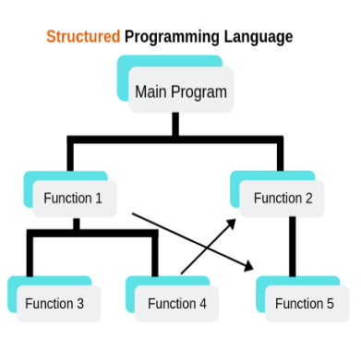
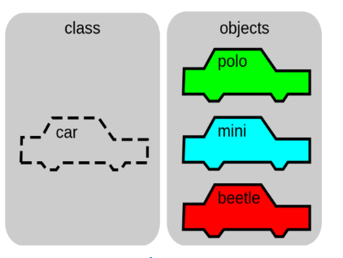
Structured vs Object Oriented Programming
Structured programming allows developing a program using a set of modules or functions
Object oriented programming allows constructing a program using a set of objects and their interactions.

Slide 4
Benefits of OOP
Modularity for easier troubleshooting.
When working with object-oriented programming languages, you know exactly where to look when something goes wrong
Reuse of code through inheritance
Flexibility through polymorphism
Effective problem solving
Object-oriented programming is ultimately about taking a huge problem and breaking it down to solvable chunks.
For each mini-problem, you write a class that does what you require.

Slide 5
Course Objectives
Object-Oriented Programming using C++.
Objects, Data Abstraction, Data Encapsulation, Polymorphism, and Inheritance.
Member access control, templates, overloaded operators, use of C++ headers, and class libraries will be studied

Slide 6
Course Learning Outcomes
At the end of this course, the students should be able to
CLO1: Describe key concepts of object-oriented programming paradigm [C1 Remembering]
CLO2: Interpret real world problems in terms of objects rather than procedure [C2 Understanding]
CLO3: Apply object-oriented programming principles to implement small and medium scale C++ programs with simple graphical user interface [C3 Applying]

Slide 7
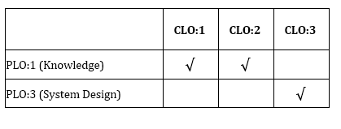
CLO-PLO Mapping

Slide 8
Marks Distribution
Grading | Marks
Assignments | 15%
Quizzes | 15%
Project | 10%
Mid Exam | 20%
Final Exam | 40%

Slide 9
Instructor
Mr. Zaheer Ahmad
Education
Mphil in Computer Science, COMSATS University, Islamabad, Pakistan.
BS, Computer Science Azad Jammu & Kashmir University, Pakistan.
Work Experience
2022-2023 Visiting Lecturer UCP
2023 to Date. Capital University of Science and Technology, Islamabad, Pakistan
Office
Block J 1st Floor, SE Office

Slide 10
Text/Reference Books
Recommended Book(s)
Introduction To C++ Programming, Comprehensive Version. Daniel Liang. 3rd Edition
Object-Oriented Programming in C++. Robert Lafore, 4th Edition
Reference Book(s)
C++: How To Program (Fourth Edition), Deitel & Deitel, Prentice-Hall.
C++ Programming: An object Oriented Approach. Forouzan and Gilberg. 2020.
Lecture Slides will be detailed enough but reading books is always a good habit

Slide 11
Required Software
Visual Studio.
Dev C++.

Slide 12
Some Basic Rules
General Discipline
DONOT use mobile phone during the lecture
Be on time. Attendance will be taken at the beginning of the lecture
Portal is your reference for this course
All the information and course material will be available there.
Send me email if you need to ask anything
Zaheer.ahamd01@cust.edu.pk
Plagiarism in homework
Submit your own work
Plagiarized work would not be accepted at all.
Zero tolerance policy

Slide 13
Attendance Policy
Minimum 75% attendance required to appear in the final exam
For missed quiz/assignment I will follow university’s policy

Slide 14
Contents
Introduction and Revision
Introduction of the course
Overview of Structured Programming using C++
Pointers Revision
Introduction to classes and Object Oriented Concepts
Creating classes
Function Overloading, C++ Constructor & Destructor
Importance of Destructor, Calling sequence of Constructor & Destructor for multiple objects
Preventing changes in data members from a method: const method
Pointer to Object; Object as argument to function (call by value & call by reference);

Slide 15
Contents Cont..
Friend classes and functions
Friend functions
Friend class
Operator overloading
Operator Overloading
Binary Operator NOT receiving Instance of class as 1st operand
Overloading Binary Operators for I/O stream
Overloading Unary Operator: as member, as non-member
Unusual Operators: ++, --, [ ] (set & get, both versions), type-cast

Slide 16
Contents Cont..
Inheritance in OOP
C++ Inheritance Concepts
Relationships in OOP
C++ Multiple Level Inheritance, Multiple Inheritance
Virtual classes and Polymorphism
Virtual inheritance
Polymorphism in C++ and Java
Virtual Functions

Slide 17
Contents Cont..
Streams
C++ Streams
Template classes and functions
Function Template
Class Template

